Slide 1
SECURE DATA HIDING IN IMAGES USING STEGANOGRAPHY
CAPSTONE PROJECT
Presented By,
Student Name : Harigovind S
College Name & Department : Mar Augusthinose College, Department of Computer Science

Slide 2
OUTLINE
Problem Statement
Technology used
Wow factor
End users
Result
Conclusion
Git-hub Link
Future scope

Slide 3
Problem Statement
Developing a Python-based Image Steganography application for securely hiding and retrieving text within images. Users can select an image, encrypt a message using pixel manipulation, and save the modified image.
This project aims to develop a secure and efficient image steganography system that can embed and extract sensitive data without significantly altering the visual appearance of the image. The system should ensure high imperceptibility, robustness against attacks, and minimal loss of image quality.
Additionally, it should incorporate encryption mechanisms to enhance security, making it difficult for unauthorized users to retrieve the hidden data. The project will focus on Least Significant Bit (LSB) substitution, transform domain techniques, and encryption methods to achieve optimal security and performance.

Slide 4
Technology used
Programming Language:
Python 3.x (Using OpenCV for image processing)
Libraries & APIs:
cv2 (OpenCV) – Image processing and pixel manipulation
NumPy – Data handling and numerical operations
OS Module – File handling and system operations
Platform Compatibility:
Operating System: Windows, macOS, Linux
Python Version: Python 3.x
Development Environment:
IDE: VS Code, Python IDE, PyCharm

Slide 5
Wow factors
Invisible Encryption – Unlike traditional cryptography, the hidden message remains undetectable to the human eye, ensuring covert communication.
Dual Security Layers – Combines steganography with encryption, making data extraction impossible without the correct key.
No Size Limitations – Can embed large amounts of text without noticeable image distortion using optimized pixel manipulation techniques.
Real-World Applications – Used in military communications, watermarking, digital forensics, and secure authentication without raising suspicion.
Lossless Data Retrieval – Ensures zero data corruption during extraction, preserving the original message intact.
Command-Line Simplicity – No need for bulky GUI applications—fast, efficient, and easy-to-use terminal-based execution.

Slide 6
End users
Government Agencies – Secure official documents and communications from unauthorized access.
Military & Intelligence Agencies – Exchange classified information without detection by embedding messages in images.
Cybersecurity Experts – Use steganography for covert communication and secure data transmission.
Digital Forensics Teams – Hide forensic data in images for evidence protection and secure storage.
Software Developers – Implement steganography in security-focused applications and digital watermarking.
Artists & Content Creators – Embed digital signatures in artwork to prevent unauthorized duplication and copyright infringement.
General Users & Privacy Enthusiasts – Protect personal messages and sensitive data from hackers and surveillance.
Corporate Organizations – Protect trade secrets and confidential documents using hidden message encryption.

Slide 7
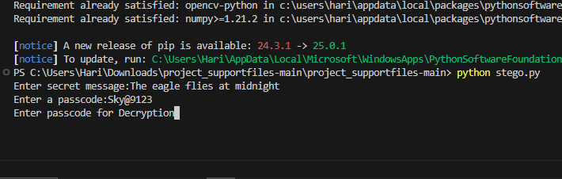
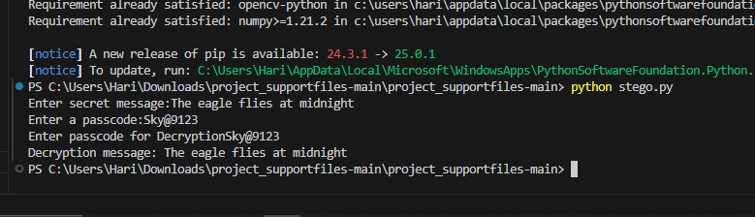
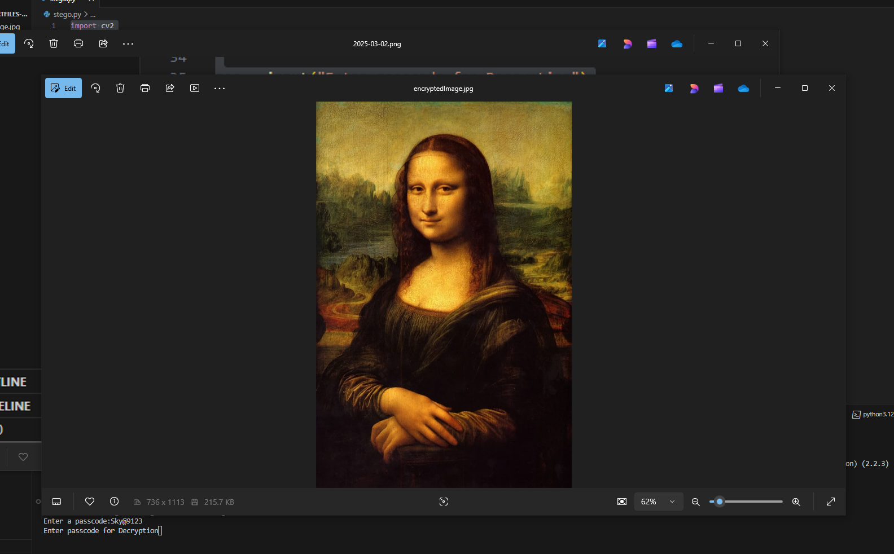
Results
User enters a secret message along with a passcode.
3. The user enters the correct passcode.
The program extracts and decrypts the hidden message, revealing the original text.
2. A new stego-image is created with the hidden message.

Slide 8
Conclusion
This project successfully implements Python-based image steganography using OpenCV to securely hide and extract messages within images. By leveraging pixel-based encryption and passcode protection, it ensures confidentiality, integrity, and unauthorized access prevention. The lossless embedding process maintains the image's visual quality while providing a lightweight, cross-platform, and user-friendly CLI interface. This makes it an efficient and practical solution for covert communication, digital watermarking, and secure data transmission.

Slide 9
GitHub Link
https://github.com/hari-144p/Edunet-CyberSecurity-Internship.git

Slide 10
Future scope(optional)
Advanced Encryption Techniques – Implementing AES or RSA encryption to enhance message security before embedding.
Adaptive Steganography – Using AI/ML to dynamically adjust pixel modifications, making detection even harder.
Support for Multiple File Types – Expanding beyond text to hide audio, video, or document files inside images.
Robust Against Attacks – Enhancing resistance to image compression, resizing, and steganalysis detection methods.
Steganography in Video & Audio – Extending the concept to hide data within video frames or audio signals for higher security.
GUI Implementation – Developing a user-friendly graphical interface for ease of use alongside the CLI version.
Cloud & Blockchain Integration – Securely storing and verifying stego-images using cloud storage and blockchain for authentication.

Slide 11
THANK YOU

